Slide 1


Learning to select context for LLM code review
TODAY: THE LLM ASKS FOR CONTEXT
Pull request
Harness
sends whole files as text
LLM
Review
PR text and diff
Codex, Cursor, Claude Code
decides which files it needs
comments on the PR
“I need more context”
The LLM decides when it has enough, so it loops: every round trip adds more tokens.
OURS: A SELECTOR PICKS IT ONCE
Pull request
Harness
Context selector
LLM
Review
PR text and diff
maps the code graph
frozen, one call
same quality, fewer tokens
ours: picks the context once
The selector picks one of 10 context levels up front; the frozen LLM reviews in one call.
Michael Liu · Ruiding Feng · Li-Hua Peng · CS536 Machine Learning II, Rutgers

Slide 2
Why the agent loop gets expensive
prompt
tool results by turn
turn 1’s result, re-sent every call
input tokens sent with each LLM call
WHY IT ADDS UP
Many calls
one LLM call per tool turn, and a review takes many turns
Repeated tokens
…
re-sent history
call k re-reads the prompt and every earlier tool result
Grows with n²
total ≈ n·P + (n²/2)·r
n turns, P the prompt, r an average tool result
call 1
call 2
call 3
call 4
call 5
call 6
call 7
call n
Schematic, not measured. Prompt caching makes the repeats cheaper, not free. Our selector sends the context once.

Slide 3

Why we switched datasets
Midpoint: ContextCRBench
Now: AACR-Bench
27,629 PRs · 46,518 one-hunk records · 99 repos
1,506
87.5%
accuracy of our trained 3B model on a 200-example pilot — the same as always guessing “merged”
real review comments on 196 PRs (50 repos, 10 languages)
How much context each comment needs
The only training target is merged or not merged
50%
34%
16%
Context is 4 packaged fields, cut off at 2,048 tokens
the diff alone
+ the whole
changed file
+ code elsewhere
in the repo
Midpoint labels were lopsided (train set)
79.5% merged
20.5%
Half the findings need more than the diff, so choosing context matters. Sources: midpoint report, AACR-Bench.

Slide 4
What one sample looks like
ContextCRBench (midpoint)
AACR-Bench (now)
pandas-dev/pandas, PR #53773 · one record
vllm-project/vllm, PR #17425 · one record
issue_title
BUG: … 'NoneType' object is not iterable
githubPrUrl
…/vllm/pull/17425
pr_title
BUG: handle none values in json.normalize()
source_commit
d803786… → 134705b…, so we can check out the whole repo
diff_hunk
+ if data is None:
+ return
category
Bug Fix · Python · 154 changed lines
8 lines of one file
comments
8 findings across 4 files. One of them:
content_before
the one changed file, 549 lines
vllm/multimodal/profiling.py : 249
review_comment
a 7-message thread on that hunk: “Isn’t this generally an issue if data is not list like?”
Repo Level
human
Code Defect
merged
false ← what we trained on
“…passes unhashable objects as arguments to logger.warning_once, which is wrapped in lru_cache…”
ContextCRBench hands you one hunk and its file. AACR-Bench gives the commits, so we trace the whole repository ourselves.

Slide 5





How we build the data
Check out the reviewed commit
Trace callers, callees and tests
Pack 10 nested levels
One JSON line per PR
with codebase-memory-mcp
The 10 levels for one real PR, FreeCAD#19411 (input tokens)
L01
PR text + diff
27k
L02
+ changed functions
56k
L03
+ whole changed files
98k
L04
+ functions they call
102k
L05
+ their callers
115k
L06
+ tests
115k, no tests found: same as L05
L07
+ guides, text search
119k
L08
calls 2 hops away
156k
L09
+ docs, more tests
156k, same as L08
L10
everything, 3 hops
256k cap
No LLM in this step · ~3 min for a large PR on a laptop · 185 of 196 PRs buildable (11 PRs’ commits are gone)

Slide 6




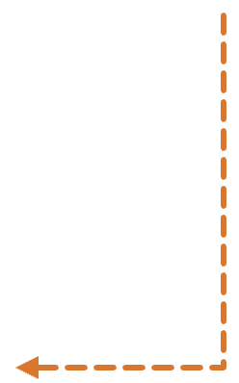




The whole system on one real PR
Input
Context Selector
(ours, trained)
Frozen reviewer
Review findings
Prompt
I · Code-graph trace
Instruction Codex /review rubric + review request
45 symbols → callers, callees, tests, docs
Selector
fθ
PR PartDesign: Fix hole centered on point edge case
{"findings": [{
"title": "<…>",
"body": "why …",
"priority": 1,
"confidence_score":
0.7,
"code_location":
{…}},
…],
"overall_correctness"
: "…"}
Diff · ExportOCAF2.cpp
- auto shape = Part::Fe…
+ parentObj, sub, nullptr,
+ Part::Feature::Transform
… 25 files · 13,071 tokens
II · Ten nested contexts
L01 diff
13k
picks one
L02 + functions
41k
prompt +
L04 · 78k
Qwen3.8-27B
L03 + files
64k
L04 + callees
78k
greedy, one call
L05 + callers
87k
L06 + tests
87k
Project folder
135k symbols
L07 + guides
91k
weights not trained
FreeCAD/ at the reviewed commit
L08 2 hops
118k
L09 + docs
119k
src/Mod/Part/App/
PartFeature.cpp
src/Mod/PartDesign/App/
FeatureHole.cpp
L10 all
256k
Codex /review JSON schema; values are placeholders
any LLM reviewer can be plugged in
Trained offline on 185 past PRs
FreeCAD#21257: diff lines, paths, counts and token sizes are real. The L04 pick and the findings are placeholders.

Slide 7
What the context selector is
INPUT
MODEL · UNDECIDED
OUTPUT
One row of numbers per PR
Context selector
One context level
Facts known before any review. Real example, FreeCAD#21257:
Gradient-boosted trees
fast; good on small tables
Diff size
25 files, 78 hunks
Changed code
45 symbols, C++
Small MLP
Callers / callees, 1 hop
171 / 258
a plain neural network
1
2
3
4
5
6
7
8
9
10
Tests found
0
A score for each of the 10 levels (illustration). The top one, here L04, is the context the LLM gets.
Guide and doc files
34
Small LLM
can also read the PR text
Tokens per level
13k → 256k
Never the reference comments or any review scores.
We compare them with cross-validation on the offline table.
Learns from the offline table which level reviews best for its tokens.
The input and output are fixed; which model sits in the middle is still open. A prediction need not match the teacher’s label — that gap is what we measure.

Slide 8

Where the reference comments come from
Two sources, one ground truth
Every comment was checked by a person
What each comment carries
391 review comments written by humans on the original GitHub PRs
a category:
80 senior engineers (2+ years each) reviewed 2,145 machine-generated comments
Security
Code Defect
plus comments generated by six LLMs, then merged and de-duplicated
Maintainability
Performance
GitHub human comments
the context level needed to find it:
LLM enhancement
Diff
File
Repo
this label is where slide 3’s 50 / 34 / 16 split comes from
in our slice: 1,506 comments on 196 PRs — 392 human, 1,114 AI
expert cross-annotation
392
1,114
consistency check
human
AI
AACR-Bench’s own annotation pipeline (arXiv:2601.19494). Expert annotation raised issue coverage by 285% over raw PR comments. Three quarters of the references are machine-written, so an LLM reviewer may score optimistically here.

Slide 9

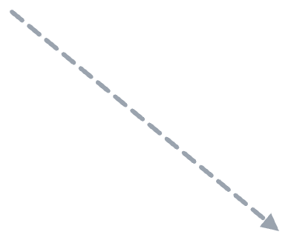
How we score a review
We match the LLM’s comments to the dataset’s reference comments on the same PR.
THE LLM’S REVIEW (5 COMMENTS)
REFERENCE COMMENTS (8)
THIS REVIEW’S SCORE
F1 · logger.py · caught #0
#0 · logger.py · AI
25%
lru_cache on *args prints again
no string match, same bug
lru_cache keys on *args
F2 · profiling.py · caught #7
#1 · logger.py · AI
recall: 2 of the 8 reference comments caught
dict passed to cached warning_once
the cache can grow without bound
40%
F3 · profiling.py · repeat of #7
same problem in the encoder path
#5 · profiling.py · AI
use %d for the token count
precision: 2 of our 5 comments caught something new
F4 · weight_utils.py · no match
split the long warning string
#7 · profiling.py · human
unhashable args reach the cache
1. Same file only
F5 · config.py · no references
2. The AACR judge decides matches
a comment on an unflagged file
+ 4 more, none of them matched
same meaning counts, even in different words
3. Repeats earn nothing
AACR-Bench’s own metric. Illustration: real vllm#17425 reference comments, made-up review.

Slide 10






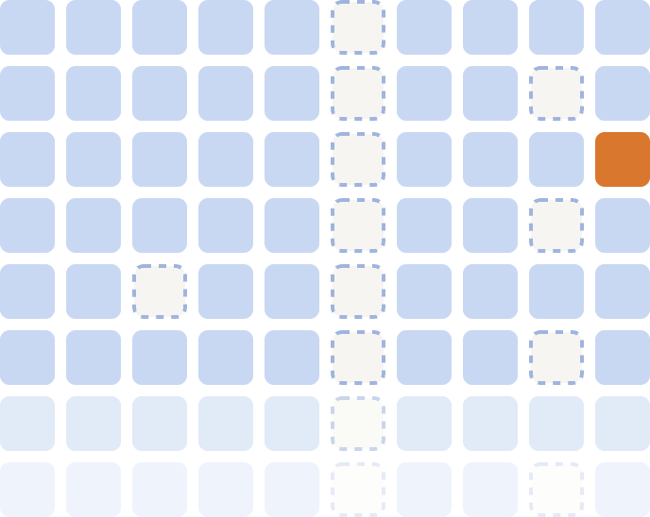
Review once, then score every level offline
Every PR × level
Frozen reviewer
AACR judge
Offline score table
185 PRs × 10 levels = 1,850 cells
Qwen3.8-27B writes one review per cell
scores it against the reference comments
every level’s recall, precision and tokens
never sees the reference comments
10 levels (L01 → L10)
FreeCAD#19411 × L10
one cell, zoomed in
[F1]
REVIEW
185 PRs
[F2]
SCORE
recall
precision
TOKENS
256,337 input tokens
same text as the level before: copied, not reviewed again
We evaluate against this table, so every model, fold and seed reuses the same reviews. Training labels come from the next slide. In the zoomed cell, review and score are placeholders; the token count is real.

Slide 11



Where the selector’s training label comes from
One level per PR — the y the selector learns to predict.
1
What the reference comments rely on
2
The deepest one sets the level
FreeCAD#21257 · an LLM that can see this PR’s reference comments R1–R4 marks the code each one needs
levels are nested, so L05 already contains L02 and L04
the reviewer never sees these comments; this step is offline only
L01
L02
L03
L04
L05
L06
L07
L08
L09
L10
13k
41k
64k
78k
87k
87k
91k
118k
119k
256k
needed by
piece of code
kind
first available at
label = L05 · 87k tokens, instead of 256k for L10
R1
R2
Feature::getTopoShape
changed
L02
R3
Hole::execute
changed
L02
3
Training set
R3
Hole::findHoles
callee
L04
input: the PR, never the reference comments
R4
ProfileBased::getTopoShapeProfileWires
caller
L05
training PR, input x
level y
FreeCAD#21257
L05
Selector
FreeCAD#19411
…
fθ
6 more pieces traced — a changed function, two callees, a caller, a guide and a test. No reference comment needs them.
… 185 PRs from 50 repos
FreeCAD#21257: pieces and levels are real. Which comment each piece supports, and so the label, is illustrative.

Slide 12
Why we cut scope
Our one task: for each PR, pick how much repository context a frozen reviewer reads.
DROPPED
LATER, IF THERE’S TIME
Predicting merges
Fine-tuning the reviewer
Picking single functions, not whole levels
An LLM selector
16 field masks on ContextCRBench
Agent reviewers

